Slide 1
Understanding Microsoft Sentinel Pricing
Feb 2022 update
Notes:
Microsoft Sentinel Pricing updates training
Hi everyone, thank you for joining us today. My name is Devrim Iyigun and I am lead our marketing efforts for Microsoft Sentinel. I am so happy to get this opportunity to walk you through the updates we have released for Microsoft Sentinel pricing model.

Slide 2
Agenda
Basics of Microsoft Sentinel pricing
Manage costs as you ingest more data
Benefit from free trials and offers
Learn more and ask for help
Notes:
In the next half hour, we will cover the basics of Sentinel pricing, the new enhancements around managing costs as you bring in more data, our current Microsoft 365 benefit, free trial and also go over resources available for you to come up with pricing estimates and get help.

Slide 3
Basics of Microsoft Sentinel pricing
Notes:
Let’s take a moment to recap Microsoft Sentinel pricing model.

Slide 4

Pricing model - based on volume of data ingested
Pay-As-You-Go
With Pay-As-You-Go pricing, customers are billed per gigabyte (GB) for the volume of data ingested for analysis in Microsoft Sentinel and stored in the Azure Monitor Log Analytics workspace.
Microsoft Sentinel – Data Ingestion
Pay-As-You-Go
Commitment Tiers
Microsoft Sentinel (Price/GB) | Log Analytics (Price/GB)
$2 | $2.30
Azure Monitor Log Analytics – Data Ingestion
Pay-As-You-Go
Commitment Tiers
Commitment Tiers
With Commitment Tiers customers billed a fixed fee based on selected tier, enabling a predictable total cost. Commitment Tiers provides a discount on the cost compared to Pay-As-You-Go pricing. Customers have the flexibility to opt out of the capacity tier any time after the first 31 days of commitment.
Azure Monitor Log Analytics – Data Retention
Pay-As-You-Go (90 days included)
Beyond 90 days: Azure Monitor Data Retention
Tier | Microsoft Sentinel * Price/day | Log Analytics-Data Ingestion* Price/day
100 GB/day | $100 | $196
200 GB/day | $180 | $368
300 GB/day | $260 | $540
400 GB/day | $333 | $704
500 GB/day | $400 | $865
1000 GB/day | $780 | $1700
2000 GB/day | $1480 | $3320
5000 GB/day | $3500 | $8050
Automation and Bring your own Machine Learning
Azure Logic Apps pricing page for related costs
Azure Machine Learning Studio and Azure Databricks pricing
Prices listed are for US East. Regional prices apply
Overage charged at selected commitment tier rate
Notes:
Our existing pricing model is based on the volume of data ingested into Microsoft Sentinel and stored in Log Analytics. When you are calculating Microsoft Sentinel price, you need to keep in mind that there are 4 primary components to the pricing model. Number 1 is the Microsoft Sentinel price, #2 is Log Analytics price, #3 is data retention price and number 4 is for customers who are using more advanced capabilities like some parts of automation and bring your own machine learning.
For Microsoft Sentinel or Log Analytics pricing, our customers today can either choose pay as you go rates or commitment tiers, where they can commit to a certain amount of data ingestion in order for greater pricing predictability. We have also made a big effort to make sure commitment tiers offer a more cost affordable option for our customers, when compared to the pay as you go rate.
If a customer chooses to use a commitment tier and uses more data than they committed, the overage will be calculated at the respective rate of their commitment tier. We have also simplified commitment tiers: there are 8 commitment tiers ranging from 100 GB/day to 5 TB/day and customers do not need to spend time on managing commitment tiers, since overage is done at the selected commitment tier.
First 90 days of data retention is included in this price and they pay 10 cents to retain their data up to 2 years.
In addition to SIEM capabilities, Microsoft Sentinel also offers security automation and response (soar ) capabilities. Some of these services may have additional charges.
Customers You can use Azure Logic Apps to automate their security responses.
They can also bring in their own machine learning models for customized analysis. In these cases the relative costs for these services are applied.
CLICK

Slide 5
Manage costs as you ingest more data
Notes:
As we are all witnessing, the volume of security data continues to grow exponentially, and data is distributed in many different stores. To defend against today’s attacks, SOC teams must have ready access to all this data. A one size fits all data model is no longer sufficient. Also, in order to meet compliance requirements and hunt for long running threats SOC teams need access to historic data.

Slide 6
Manage costs as you ingest more data
Current features
New features
Analytics Logs
Full KQL, Alerts supported, No query limits, 90 days included
Basic Logs
Reduced KQL, Alerts not supported, Query concurrency limits, 8 days retention included
Ingestion charge
Log Analytics: $1.6 to $2.3/GB
Microsoft Sentinel: $0.7 to $2.0/GB
Query charge
N/A
Ingestion charge
Log Analytics: $0.50/GB;
Microsoft Sentinel: $0.50/GB
Commitment Tiers not available
Search query charge
Log Analytics: $0.005/GB-scanned;
Data retention
Full KQL, 90 days included, 2-year max. retention
$0.10/GB-month
Search job charge*:
$0.005/GB -scanned
Restore charge
$0.10/GB/day*
Min. daily charge for 2TB and 12-hours (~$96)
*pro-rated hourly
Data archive
Batch queries with limited KQL, 0 to 7-year max. archive
Data Archive Charge: $0.02/GB/month
Notes:
To address these concerns and help SOC teams, we introduced a new type of logs, we call Basic logs, that enable collection of voluminous data sets that traditionally customers have not ingested due to cost considerations. To help our customers reduce costs while they ingest more data, Microsoft Sentinel now offers the ability to ingest Log Analytics Basic logs at $1/GB. Basic logs can be accessed on demand for ad-hoc querying, investigations automated playbooks and search. Some examples include NSG flow logs, Custom Logs, Container Logs, and AppTraces. Basic Logs will be accessible for interactive queries for the first 8 days. Afterwards archived logs can be enabled to store the data. There will be a nominal 0.5cents / GB charge for running search queries on Basic Logs.
To recap, on the left handside is our existing pricing model. Showing cost for Analytics Logs. Analytics logs that include high value, security data that reflect the status, usage, security posture and performance of the customers environment. Analytics logs are best monitored proactively, with scheduled alerts and analytics, enabling security detections. To the right we have Basic Logs, which are complementary to Analytics logs, come with some limitations and are cheaper up to 1/4th of analytics logs.
CLICK:
In addition, we are adding a fully managed, cost-effective data archiving solution for logs that need to be kept for several years for compliance and can be accessed to investigate an incident. Data can now be archived up to 7 years at 2 cents/ GB/month. The archived logs support all logs that exceed its original or extended retention, whether they are analytics logs or basic logs.
CLICK:
We are also announcing a new approach for interacting with data in real time with a new search capability. The new search experience empowers security analysts to easily search all logs (including basic, analytics and archive) to hunt for threats. Analysts can search massive volumes of security data going back years. Having this data at their fingertips is vital to combat long running threats like the Nobelium breach or meeting compliance requirements. For searches performed on Basic and/or Archived Logs, search jobs are charged by the amount of data scanned to complete the search.
If they want to search on this data there is an additional 0.5 cents /GB for scanned data.
CLICK
Log Data Restore is the restoration of historical log data from Log Data Archive into a high performance cache for fast queries and advanced analytics. Log Data Restore is billed based on the amount of log data restored and the amount of time for which data is kept restored. The cost is 10 cents/ GB/day. A minimum charge of 2TB for 12-hours applies to every restore; pro-rated hourly.

Slide 7
Trials and offers

Slide 8
Trials and offers
1
Microsoft Sentinel free trial
2
Microsoft Sentinel benefit for Microsoft 365 E5, A5, F5 and G5* customers
3
Always free data sources
4
Field empowerment

Slide 9



1. Microsoft Sentinel free trial
Ingest up to 10GB/day for first 31 days
OR
Add Microsoft Sentinel to your existing Log Analytics for free for first 31 days
Microsoft Sentinel
Azure Monitor Log Analytics
Usage beyond these limits will be charged per pricing listed on this page.
Charges related to additional capabilities for automation and bring your own machine learning are still applicable during the free trial.

Slide 10

2. Microsoft Sentinel benefit for Microsoft 365 E5, A5, F5 and G5* customers
Save up to US2200/month on a typical 3,500 seat deployment of Microsoft 365 E5 with up to 5MB per user/day of free data ingestion into Microsoft Sentinel
Applied automatically at the end of the month – no enrollment or nomination process
Eligibility: Microsoft 365 E5, A5, F5 and G5* or Microsoft 365 E5, A5, F5 and G5* security customers
Data sources included in the offer:
Azure Active Directory (Azure AD) sign-in and audit logs
Microsoft Cloud App Security shadow IT discovery logs
Microsoft Information Protection logs
Microsoft 365 advanced hunting data
https://aka.ms/m365-sentinel-offer
Internal FAQ on GearUp
*Microsoft waives any and all entitlement to compensation for the services provided to you under this agreement. Microsoft intends that these services and associated terms be in compliance with applicable laws and regulations with respect to gratuitous services. It is specifically understood that all services and services deliverables provided are for the sole benefit and use of the government entity and are not provided for personal use or benefit of any individual government employee.

Slide 11

3. Always free data sources
Azure Activity Logs
Office 365 Audit Logs, including all SharePoint activity, Exchange admin activity, and Teams
Alerts from Microsoft Defender for Cloud, Microsoft 365 Defender, Microsoft Defender for Office 365, Microsoft Defender for Identity, Microsoft Defender for Endpoint and Microsoft Defender for Cloud Apps

Slide 12
4. Field empowerment
Field empowered to offer up to 35% discount on Microsoft Sentinel and Azure Monitor Log Analytics commitment tiers
Discounts beyond 35% field empowerment require business desk approval (via BD360 tool)
SKU Discount Cap by Approver
Deal Discount Amount Cap
Approver level | Discount cap
Blue | 15%
Yellow | 25%
Red | 30%
Teal | 30%
Purple | 35%
Blue | $250k
Green | $250k
Yellow | $500k
Red | $2M
Teal | $2.8M
Purple | $8M

Slide 13
Business Desk
The Business Desk drives appropriate business behavior to assist the sales team and provides innovative business solutions to the customers that empower our customers to achieve their digital transformation objectives
Volume Licensing
Engage with Business Desk regarding a customer negotiation of any type (pre-sales or post), product mix, location or customer segmentation. Based on customer, location, and scenario the submission will be route to the appropriate team to address.
Choose a Sector: Academic, Commercial or Public
Partner Solutions
Engage with Business Desk regarding thru-partner deal constructs and concessions. This would include anything from Outsourcer Enrollments, Managed Services Exceptions, SPLA, CSP, MPA, ISVR, etc.
Choose a Sector: Academic, Commercial, Public, Channel Enablement
Services
Engage with Business Desk regarding a customer negotiation of any type (pre-sales or post), product mix, location or customer segmentation. Based on customer, location and scenario the submission will be route to the appropriate team to address.
Choose a Sector: Consulting or Support
Business Desk Request Portal – PowerPoint walk through
Business Desk Request Portal – Video walk through

Slide 14
Learn more and ask for help

Slide 15
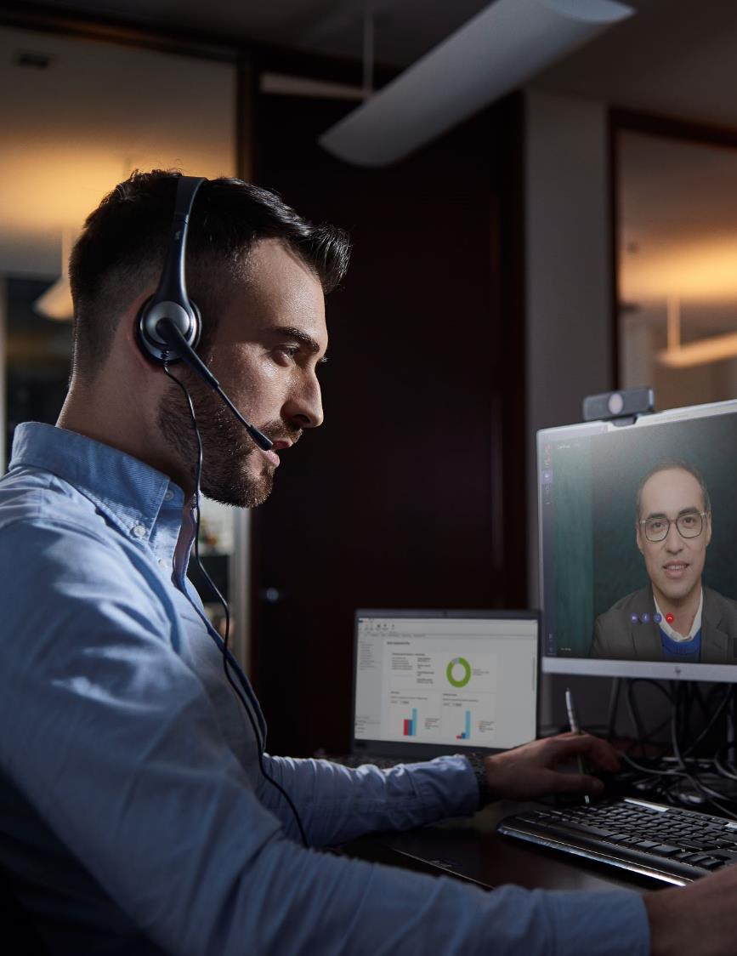

Pricing resources
Where to go if you need help or more info
Leverage the updated data sizing and pricing calculator to create estimates for customers
Use the Value Calculator to help create business cases
Reference billing documentation for in-depth info about billing, free data tables, and more
If you need additional discounts or pricing help on a deal, contact business desk
More information: S100 Sales Guidance
The Total Economic Impact of Microsoft Sentinel

Slide 16
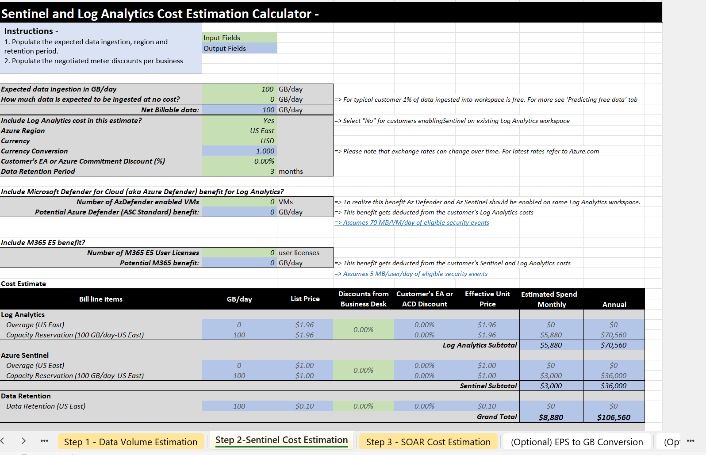
Data sizing and pricing calculator

Slide 17
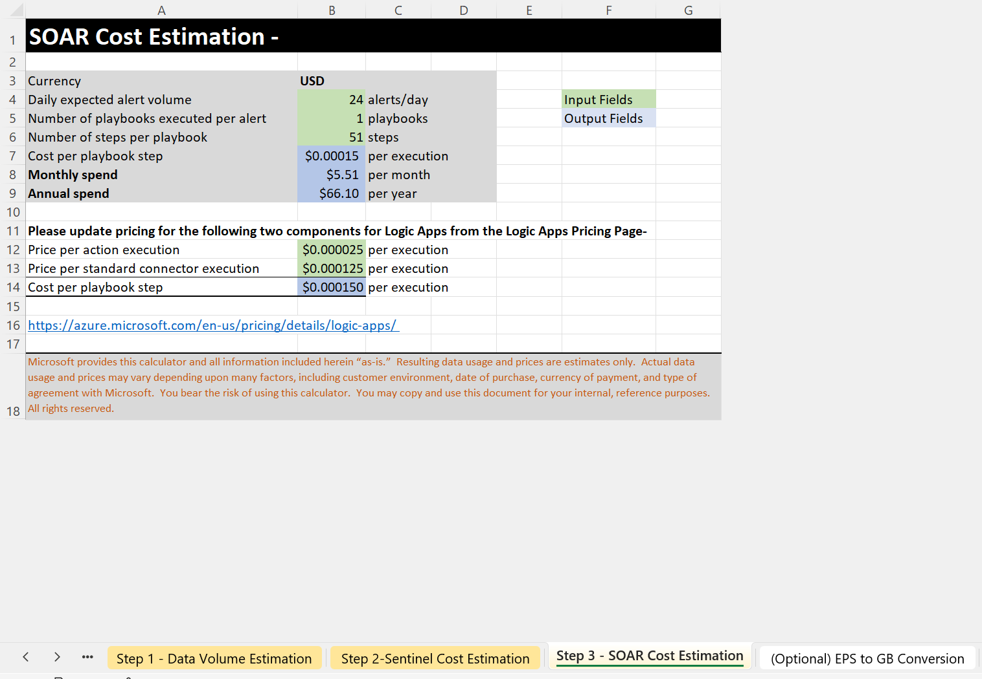
Data sizing and pricing calculator cont’d

Slide 18
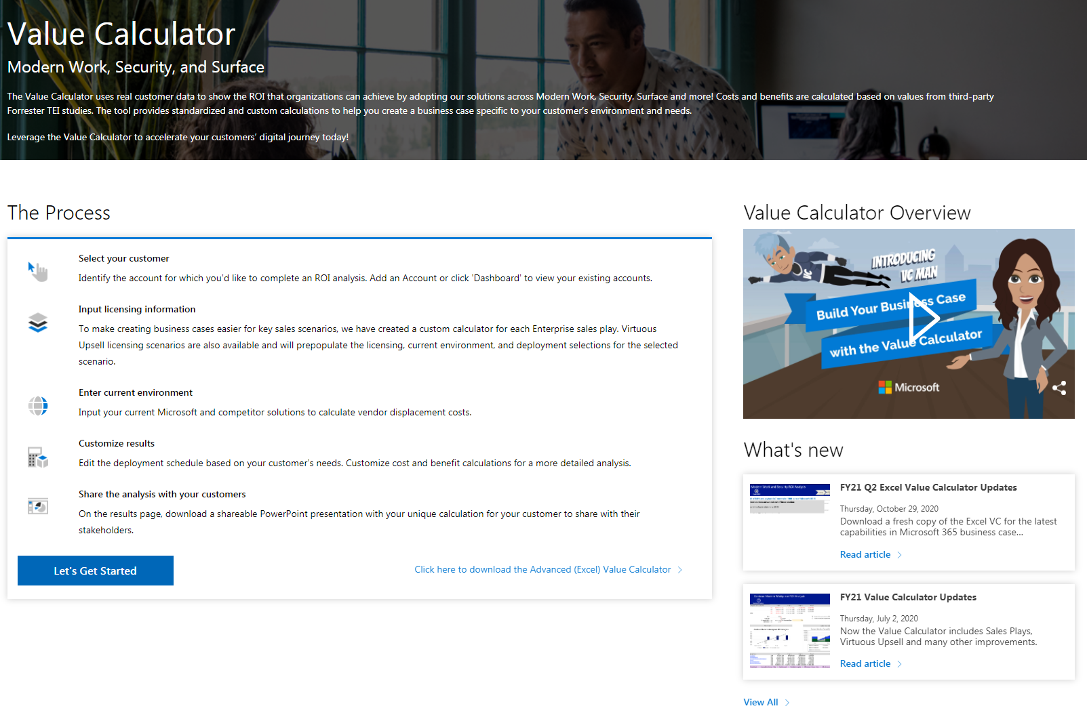
Total Value Calculator
Calculate the total value of Microsoft Sentinel to help you build business cases for customers
Includes all MW products but can be used for only Microsoft Sentinel
Includes the TEI model created by Forrester for the Total Economic Impact of Microsoft Sentinel study
Download the Excel version to fully customize to your customer
How-to guides are linked in the spreadsheet
https://vc.transform.microsoft.com/

Slide 19
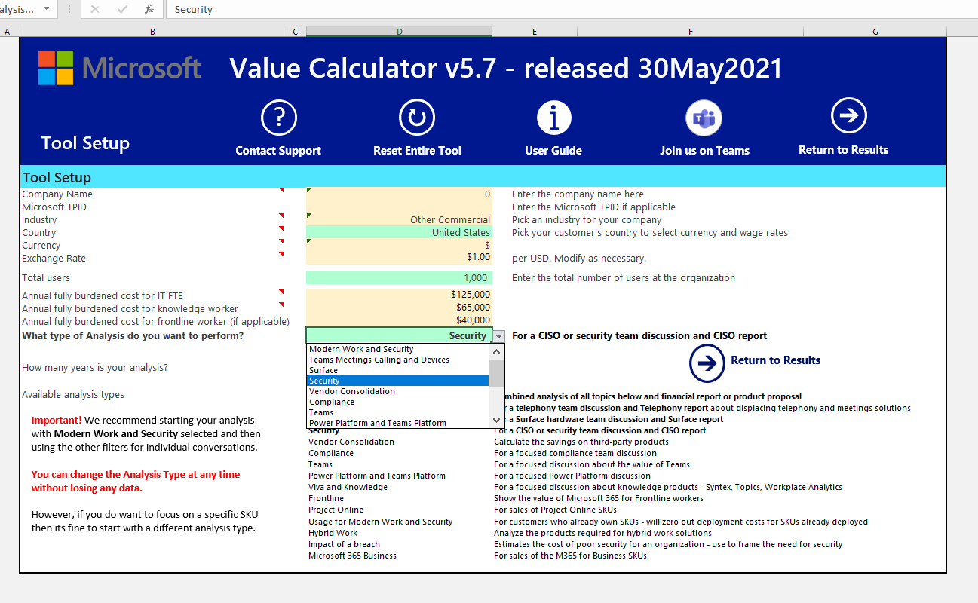
Value Calculator screenshot pt 1
Select “Security” and run results to narrow the tool to security solutions

Slide 20
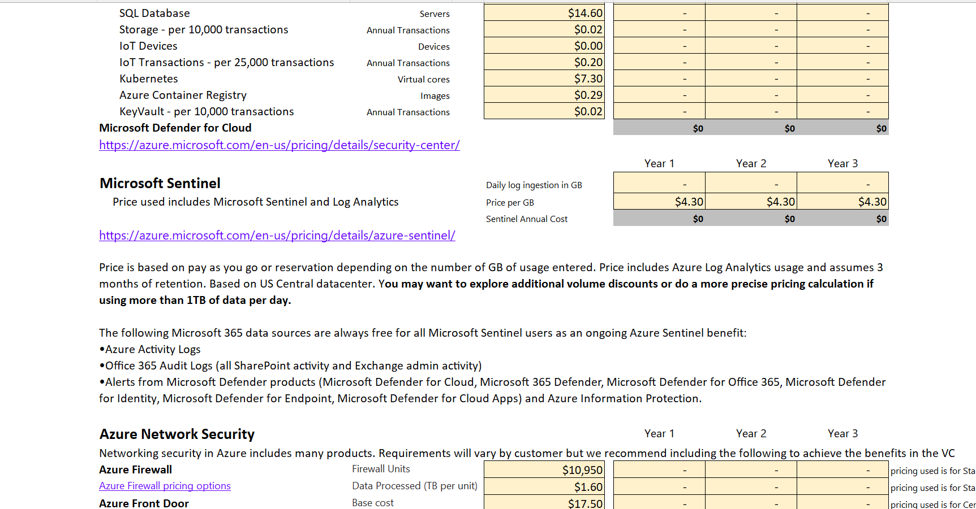
Value Calculator screenshot pt 2
Once you run analysis, you can fill out only Microsoft Sentinel information and ignore the rest if needed

Slide 21
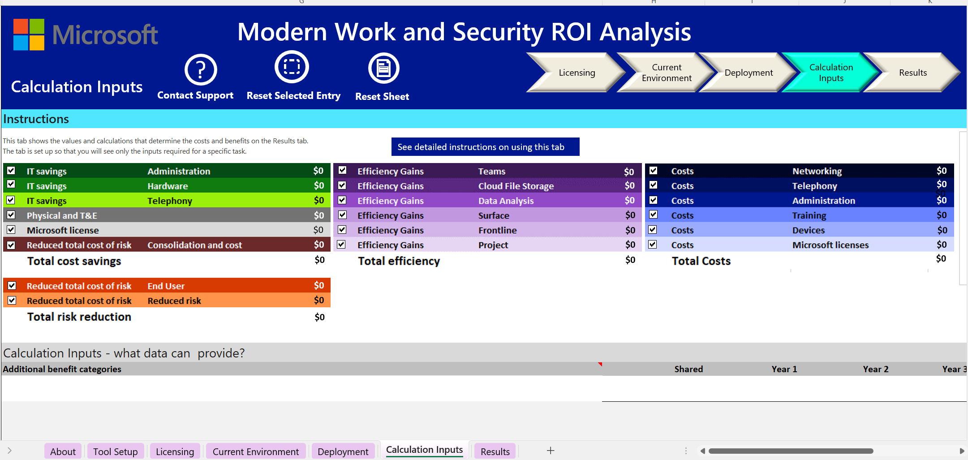
ROI Analysis screenshot
Customize the individual factors of the TEI model as needed for your customer
Customize to your customers environment in each tab

Slide 22
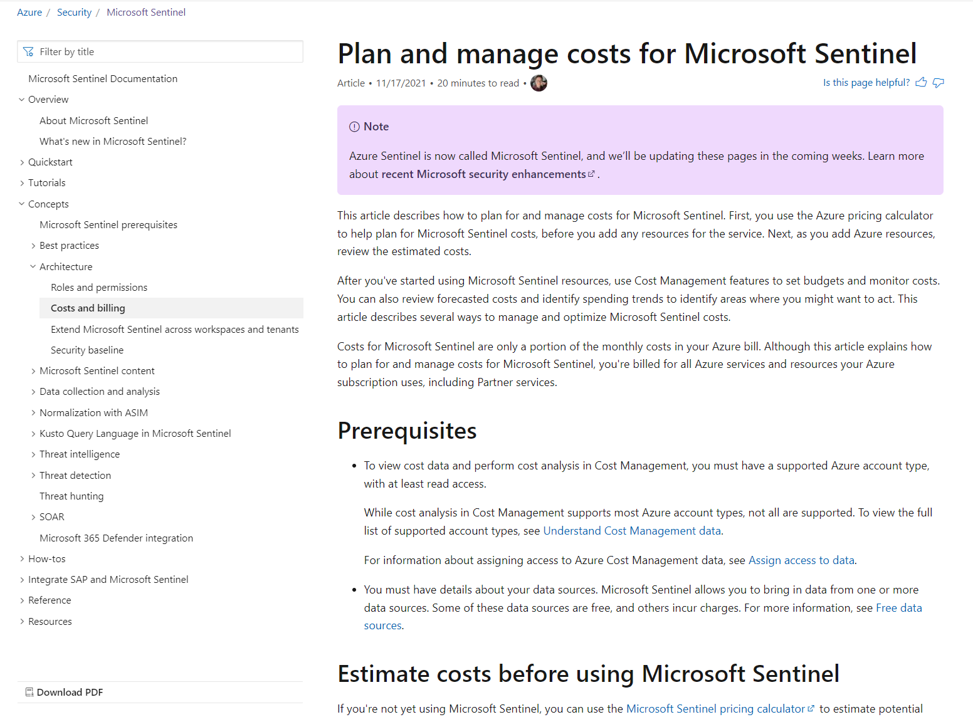
Billing documentation
Outlines pricing details and cost management in detail
Includes table-by-table breakdown of free data sources (including which tables are free and which are paid for connectors that include both)
Publicly hosted in docs—please share with customers who have billing questions!
Includes cost management guidance
aka.ms/sentinel-billing-docs

Slide 23
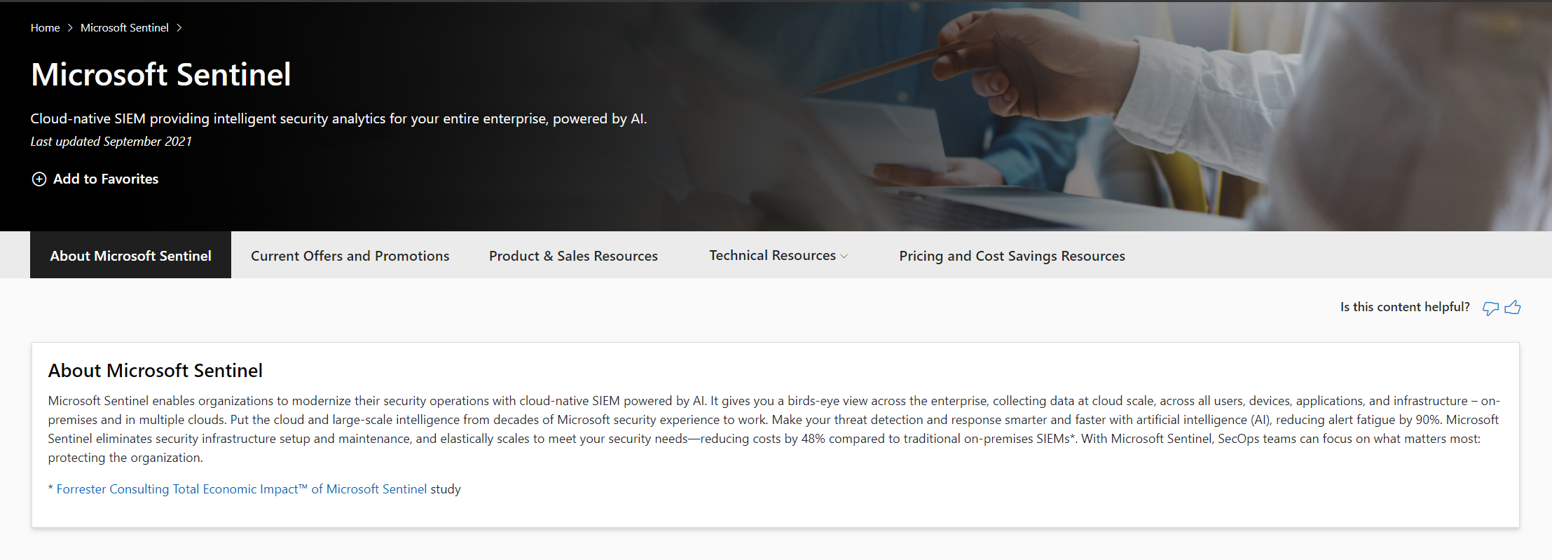
Resources consolidated and organized on GearUp
Current offers and promotions
Product and sales resources
Technical resources (incl. best practices, architecture design, migration, data management)
Pricing and cost resources
aka.ms/sentinel-gearup

Slide 24

Take action: Get started today with our free trial
Start a free trial with Microsoft Sentinel
Open Microsoft Sentinel dashboard in Azure portal
Choose the solutions in the Content Hub to address your use cases
To learn more, visit Microsoft Sentinel

Slide 25
Thanks!

